Slide 1
Meal Scout
A recipe finder app
Bogdan Petrescu

Slide 2
Overview
Meal Scout is an application that helps users discover and prepare recipes based on what ingredients they have lying around in the kitchen. It aims to make cooking more convenient by suggesting recipes using what's already available in the kitchen.
Users can search for recipes by inputting ingredients they already have.

Slide 3
Key Stakeholders
Users: The primary stakeholders are the users. They will include people who are looking for recipes, meal planning assistance, and ways to reduce food waste. Their satisfaction and engagement are paramount.
Developers: The development team, including programmers, designers, and quality assurance testers, are critical stakeholders. They are responsible for creating, maintaining, and improving the app.
Product Manager: They oversee the development and alignment with user needs and business objectives. They are responsible for prioritizing features and making decisions on functionality.
Content Providers: The app includes recipes and culinary content. Collaboration with content creators, chefs, or food bloggers to provide content. They could be stakeholders in terms of content quality and consistency.

Slide 4
Survey
As a survey method we’ve contacted several cooking communities through forums and asked what features they would like our app to have.
Needs:
What features would you like the app to have?
Features prioritisation:
Listed potential features and asked respondents to prioritise them.
Wishlist:
Allow respondents to express their wishes or ideas freely.
Moscow prioritisation
Based on user feedback the app:
Users should have the option to log in, though could use the app without registration;
Users must be able to search for recipes based on a list of ingredients;
Users must be able filter results based on dietary requirements(vegan, vegetarian, gluten free)

Slide 5
Specifications
User Registration and Profiles:
Users can create accounts or log in with social media.
User profiles with saved recipes and dietary preferences.
Recipe Search:
Users can search for recipes using keywords, ingredients, list of ingredients or categories.
Advanced search filters like cooking time, and dietary restrictions (vegetarian, vegan, gluten-free, etc.).
Ingredient Scanner:
Users can scan barcodes or manually input ingredients they have at home.
The app suggests recipes based on available ingredients.
Recipe Recommendations:
Personalised recipe recommendations based on user preferences and past interactions with the app.
"Recipe of the Day" and popular recipes.
Recipe Details:
Detailed recipe pages with ingredients, step-by-step instructions, nutritional information, and user reviews.
Save and Share:
Users can save their favourite recipes for future reference.
Share recipes with friends and family via social media or email.
User Reviews and Ratings:
Users can rate and review recipes.
Average ratings and reviews for each recipe.
Admin Dashboard:
An admin panel to manage recipes, user accounts, and app content.

Slide 6
Technologies to be used:
Front-end
Chrome
Javascript
HTML
CSS
Libraries
bootstrap css framework
API
Recipe websites api: Recipe - Food - Nutrition API, Recipe by API-Ninjas API, Random Recipes API, Recipe and Ingredient, Analysis API, RecipesAPI, Low Carb Recipes API, Recipe Puppy API, Recipe Generator API, Random Recipes API, Recipe Parser API.
Social Sharing APIs:Facebook Graph API, Twitter API: For social sharing and authentication.
Review and Ratings APIs: Yelp Fusion API: Lets users read and write reviews for restaurants or food-related businesses.
OpenTable API: For restaurant reservations and reviews.
Backend
Database - for user registration purposes
Sqlite
Sql
C#
Data Storage and Backend Services: AWS or Firebase (for backend and data storage): Use a cloud-based solution to store user data, recipes.

Slide 7
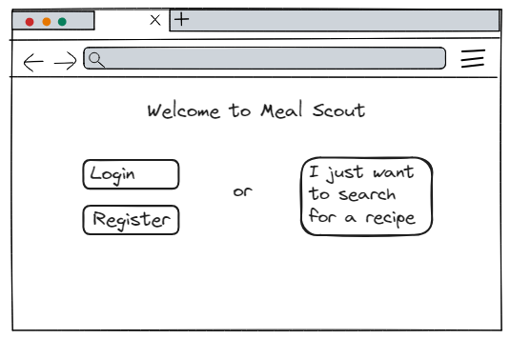
Wireframe - user journey
1
Users can choose to login and
see their saved recipes or
search for a recipe as a guest.

Slide 8
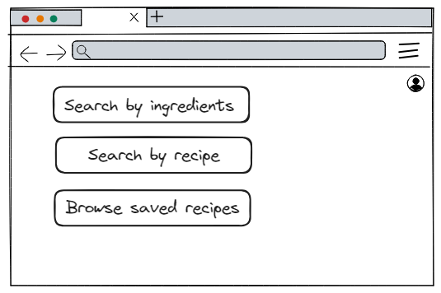
Wireframe - user journey
2
Once logged in, users can choose
a search type or browse saved
recipes
Only if user is logged in

Slide 9
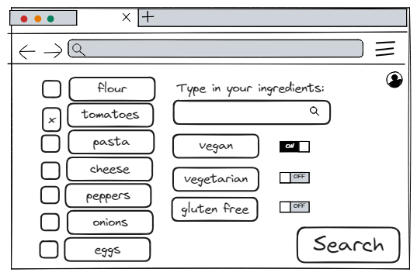
Wireframe - user journey
3
Ingredients can be typed in or
checked from a list of
usual(most used) ingredients.
User can filter results using
the on screen options

Slide 10
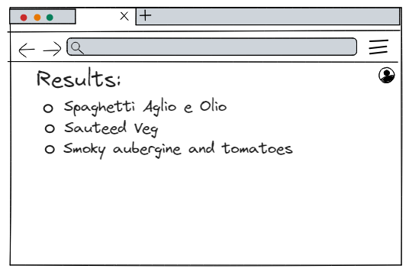
Wireframe - user journey
4
Results page

Slide 11
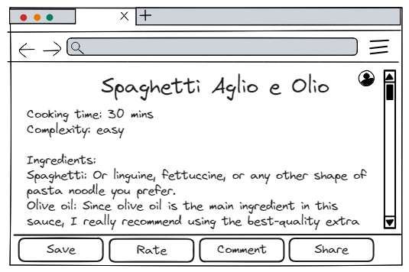
Wireframe - user journey
5
The recipe page

Slide 12
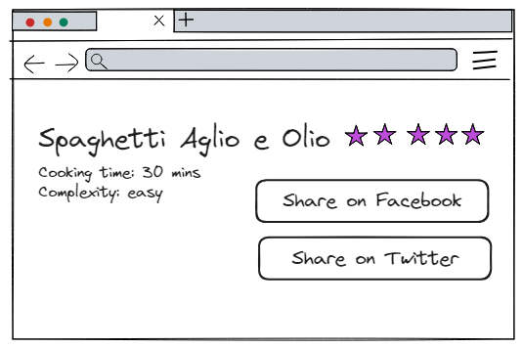
Wireframe - user journey
6
Final screen, where the user
can share, rate or comment on
the recipe.

Slide 13
Further development
User Registration and Profiles:
Users can log in with social media.

